Slide 1


MINING TECHNIQUES
Classification & Clustering in Practice
INSTITUTION
INSTRUCTOR
Moodalakatte Institute of Technology (MITK)
Abdul Muqeet Armar
Kandavara, Kundapura, Karnataka
M.Tech CSE
Welcome MCA students to this 2-hour practical session. State clearly that today we demystify theory through code that matches their laboratory repository directly.

Slide 2





What Will We Learn Today?
01. Classification (Supervised)
02. Clustering (Unsupervised)
1. Decision Tree
1. k-Means Clustering
Hierarchical questions and if-else logic
Centroid recomputation & partitioning
2. k-Nearest Neighbors (k-NN)
2. Hierarchical Clustering
Distance calculation and majority voting
Agglomerative merging & dendrograms
3. Naive Bayes
From Concept → Algorithm → Python Code
Probability and word independence
Emphasize that we are strictly focusing on 5 core algorithms that match their lab folders: 3 for classification, 2 for clustering. No fluff, pure foundational clarity.

Slide 3



What is Data Mining?
“Data Mining is the process of finding useful patterns and actionable knowledge from raw data.”
10,000+ Student Records
Analyze Data
Discover Patterns
Useful Knowledge
Marks, attendance, study hours, lab performance
Clean, filter, and run mining algorithms
“Attendance < 75% often correlates with backlogs”
Timely remedial tutoring intervention
Analogy: Just as gold miners sift tons of earth to find valuable gold nuggets, computer scientists sift through gigabytes of raw data to discover valuable insights.

Slide 4


What are Mining Techniques?
Mining techniques are algorithmic methods used to discover structures, predict outcomes, or partition observations automatically. Today we master the two most important pillars:
Classification
Clustering
Goal: Predict a known, predefined category or label.
Goal: Discover natural, hidden groups in unlabeled data.
The model is trained with past historical data that already contains correct answers (labels). It learns the mapping rule to predict the label of fresh, unseen data.
No correct answers or class labels are given beforehand. The algorithm looks at similarities and distances between data points to group them automatically.
Ask a student: "If I give you 100 emails and tell you which ones are spam, what technique is it?" (Classification). "If I give you 100 books without genre tags and ask you to group similar ones?" (Clustering).

Slide 5
Classification vs. Clustering
Feature | Classification | Clustering
Learning Paradigm | Supervised Learning (Teacher present) | Unsupervised Learning (Self-discovery)
Target Labels | Target labels are provided during training | No target labels exist in the dataset
Primary Objective | Assign a new sample into a predefined class | Discover organic subgroups based on similarity
Real-world Example | Medical diagnosis: Disease present (Yes / No) | Market segmentation: High, medium, low spenders
Our Lab Algorithms | Decision Tree, k-NN, Naive Bayes | k-Means, Hierarchical Clustering
Have students note this table down. In university exams and technical interviews, "Differentiate between Supervised Classification and Unsupervised Clustering" is a guaranteed question.

Slide 6

What is Classification?
Classification means mapping input data features to a predefined discrete class.
Example 1: Student Academic Standing
Example 2: Email Filtering
Inputs (Features): Study Hours + Class Attendance
Inputs (Features): Subject line, sender address, keywords
Target Class: or
Target Class: or
Emphasize the word "Discrete". In classification, outputs are finite categories (Yes/No, Red/Blue, Class A/B). If the output was a continuous number like predicting exact percentage (e.g. 78.4%), that is Regression, not Classification.

Slide 7



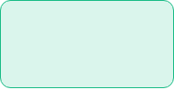

How Classification Works
Training Data
Learn Patterns
Trained Model
New Unseen Data
Predicted Class
Features (X) + Known Labels (y)
Model optimizes decision boundaries
Mathematical rules locked in memory
Features only (No label given)
Pass or Fail output
Training Phase
Testing / Prediction Phase
We feed the model hundreds of past records with both inputs and true outcomes. The algorithm adjusts its internal parameters to minimize error.
A new student walks into college. We record their study hours and attendance. The model outputs a prediction immediately without human intervention.
Draw attention to X (features) and y (target). In Scikit-Learn, we will always call model.fit(X_train, y_train) for training, and model.predict(X_new) for testing.

Slide 8





Decision Tree: Asking Sequential Questions
A Decision Tree breaks down complex decisions into a sequence of simple, transparent if-else questions based on feature values.
1. Root Node
ROOT NODE
The very first question at the top of the tree, representing the most informative feature.
← NO YES →
2. Decision Node / Branch
Splits into sub-branches based on the answer (Yes or No).
Leaf
3. Leaf Node (Terminal)
The final output label (Pass or Fail) where no further questions are asked.
Highlight interpretability: Decision Trees are popular because unlike black-box deep learning, humans can inspect and explain every single decision branch.

Slide 9



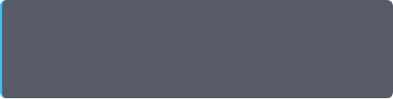
Real-Life Analogy: The Umbrella Decision
Everyday Human Logic
Machine Learning Translation
Every morning in coastal Karnataka (Kundapura), you decide whether to carry an umbrella:
A Machine Learning model follows the exact same structure:
1. Features: Humidity, Wind Speed, Cloud Cover
• Question 1: Is it currently raining outside?
2. Threshold Test: Is Humidity > 80%?
→ If YES → Take Umbrella!
3. Branch Selection: Traverse left or right
• Question 2: If NO, is the sky heavily overcast?
4. Prediction: 1 (Carry) or 0 (Don't Carry)
→ If YES → Take Umbrella!
→ If NO → Leave Umbrella at home.
The algorithm finds the best threshold split automatically from past data.
Connect this everyday Kundapura monsoon experience directly to data attributes. Tell students: "You are already using decision trees in your brain every single morning!"

Slide 10

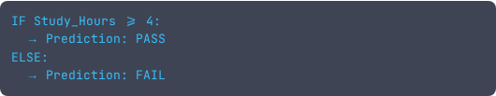
Learning from Example Records
Tiny Training Dataset (5 Students)
Student ID | Study Hours (X1) | Attendance % (X2) | Result (y)
S1 | 2 | 60% | Fail
S2 | 3 | 65% | Fail
S3 | 4 | 70% | Pass
S4 | 5 | 75% | Pass
S5 | 6 | 80% | Pass
What Does the Tree Learn?
By observing these 5 rows, the Decision Tree algorithm detects a pure split point:
Notice how 100% of students studying 4+ hours passed. The algorithm creates a clean boundary with zero training error.
Point out the split boundary at 3.5 or 4 hours. Explain that the algorithm searches through all possible split values to find the one that best separates Pass from Fail.

Slide 11

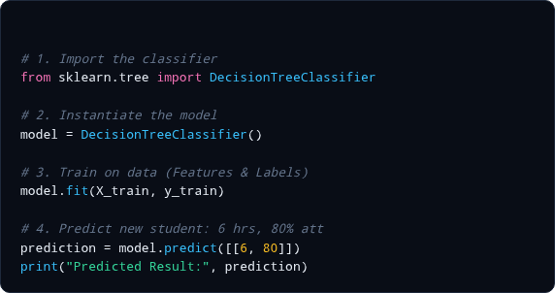



Decision Tree in Python (Scikit-Learn)
01_CLASSIFICATION/01_DECISION_TREE/DECISION_TREE.PY PYTHON 3.10+
Step 1 & 2: Import & Initialize
Scikit-learn gives us pre-built, highly optimized decision tree classes.
Step 3: .fit(X, y)
This single line builds the tree branches and calculates information gains internally.
Step 4: .predict()
Pass new feature vector [[6, 80]] to receive the predicted label instantly.
Action: Switch screen to VS Code and open `01_decision_tree/decision_tree.py`. Run it in terminal so students see `['Pass']` printed in real time.

Slide 12

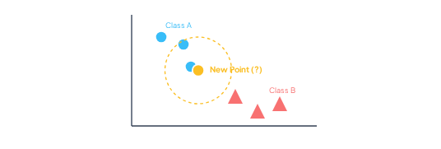
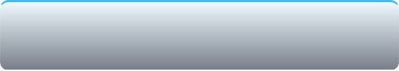
k-Nearest Neighbors (k-NN)
“Tell me who your neighbors are, and I will tell you who you are.”
To classify a new unknown data point, k-NN calculates Euclidean distances to all known points in feature space and inspects the closest K neighbors.
Key Philosophy:
Similar things exist in close proximity. If a new student's study hours and attendance resemble three students who passed, that student will most likely pass too.
Yellow dashed circle represents nearest neighborhood radius
Draw a point on whiteboard between two distinct clusters. Ask students: "If you had to vote based on distance alone, what team does this point belong to?"

Slide 13




How k-NN Works: The Voting Process
New Point Arrives
Compute Distances
Select K Closest
Majority Voting
Assign Winner
Coordinates (x1, x2)
Euclidean metric to all points
e.g., K = 3 nearest rows
Count label votes among K
Majority label assigned
Concrete Voting Walkthrough (Setting K = 3):
Neighbor 1: Distance = 1.2 →
VOTE COUNT
Neighbor 2: Distance = 1.8 →
Class A (2) vs Class B (1)
Neighbor 3: Distance = 2.4 →
Prediction = Class A Wins!
Emphasize why we usually pick odd numbers for K (like 3, 5, 7) for binary classification: it prevents 50-50 tie situations in voting.

Slide 14
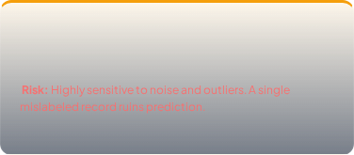
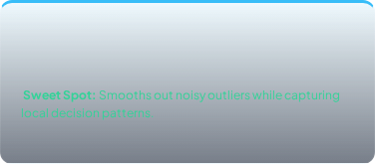
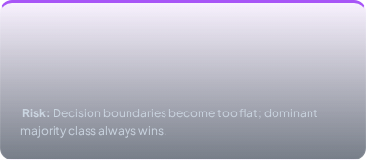
What Does K Mean in k-NN?
K = 1
K = 3 or 5 (Balanced)
K = Very Large (e.g. 50)
Looks strictly at the single closest point.
Considers a small committee of closest samples.
Considers points far away across the entire dataset.
General Rule of Thumb:
Choose an odd value like K = 3 or K = 5 to guarantee a clear majority decision in binary classification.
Ask students: "If there are 100 students in the class, 90 boys and 10 girls, what happens if we set K = 99?" The boys will win every vote! That's why large K over-smoothes.

Slide 15


k-NN Example: Body Health Classification
Known Patient Database
Classifying New Patient X
Person | Height (cm) | Weight (kg) | Status
Person A | 170 | 65 | Normal
Person B | 172 | 68 | Normal
Person C | 160 | 85 | Overweight
Person D | 175 | 70 | Normal
Step 1: Distance to Person A → ~1.41 (Very close)
Step 2: Distance to Person B → ~2.23 (Close)
Step 3: Distance to Person D → ~5.65 (Close)
Step 4: Distance to Person C → ~21.9 (Far away)
Demonstrate how intuitive distance is. Point out that Person X is physically adjacent to Persons A, B, and D in height/weight space.

Slide 16

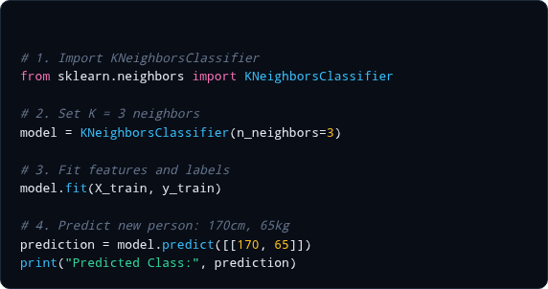

k-NN in Python (Scikit-Learn)
01_CLASSIFICATION/02_KNN/KNN_CLASSIFIER.PY PYTHON 3.10+
n_neighbors=3 Parameter
This tells the algorithm to query exactly the 3 closest records when classifying.
Lazy Learning Characteristic
k-NN does not build an explicit mathematical formula during .fit(); it simply stores the data and does calculations on-the-fly during .predict()!
Introduce the term "Lazy Learner" in casual terms: k-NN is like a student who doesn't study before exam day, but memorizes the textbook and looks up the closest page when answering questions!

Slide 17




Why Feature Scaling Matters in k-NN
The Problem: Scale Imbalance
The Solution: StandardScaler
Imagine classifying loan applicants with two features:
We normalize all features to the same numerical scale (e.g. 0 to 1 or zero mean):
from
import
StandardScaler
StandardScaler
fit_transform
Because Euclidean distance squares differences:
Distance = √((ΔAge)² + (ΔSalary)²)
Salary completely dwarfs Age! Age becomes invisible.
After scaling, both Age and Salary contribute equally to distance calculations.
Emphasize: "Any algorithm relying on distance metrics (k-NN, k-Means) MUST have scaled features. Decision Trees do not care about scaling because they split one feature at a time."

Slide 18



Naive Bayes: Probability-Based Classification
Naive Bayes uses Bayes' Theorem of Probability to decide which class is most likely.
Incoming Message Scenario
How It Thinks
The model consults frequency counts from historical training emails:
Question for the Model: What is the probability this is Spam vs Not Spam?
By multiplying individual word probabilities together, Spam receives a vastly higher final score!
Reassure students: Don't fear Bayes Theorem formula P(A|B) = P(B|A)P(A)/P(B). Focus on the core logic: "Count how often words appeared in spam previously, and multiply probabilities."

Slide 19



Why is it Called “Naive”?
The “Naive” Assumption
Why It Still Works Miracles!
It is called naive (innocent / simplistic) because it assumes that all features are completely independent of each other.
Even though the independence assumption is mathematically untrue in real life:
Extremely fast training (just counting frequencies)
Requires very little memory
Unmatched baseline accuracy for text/spam detection
“All models are wrong, but some are useful.” — George Box
Naive Bayes pretends each word acts completely on its own, ignoring grammar and word order!
Emphasize this definition! MCA examiners love asking: "Why is the Naive Bayes classifier called naive?" The single line answer is: "Because it assumes feature independence."

Slide 20




Naive Bayes Workflow for Text
Training Emails
Count Frequencies
Calculate P(Word|Class)
Test Message
Highest Score
Spam & Ham datasets
How often each word occurs
Build probability lookup table
Multiply probabilities
Output: SPAM
Simple Probability Comparison
P(Spam | “win free cash”)
P(Not Spam | “win free cash”)
0.00084
0.00002
Lower probability
Highlight: We don't even need the denominator P(Data) because it is identical for both classes. We just compare the numerators!

Slide 21

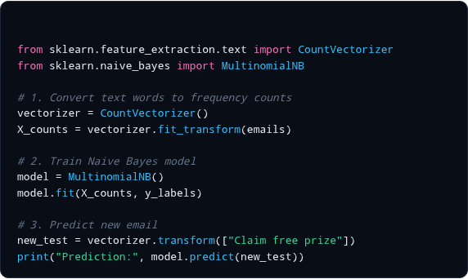

Naive Bayes in Python (MultinomialNB)
01_CLASSIFICATION/03_NAIVE_BAYES/SPAM_CLASSIFIER.PY PYTHON 3.10+
Why CountVectorizer?
Computers don't understand words; they understand numbers. CountVectorizer turns sentences into word frequency matrix columns.
Why MultinomialNB?
Multinomial Naive Bayes is designed specifically for discrete count data like word frequencies in text mining.
Demonstrate the Python script `03_naive_bayes/spam_classifier.py`. Show students how typing "Meeting tomorrow at 10 AM" outputs "Ham", but "Win free cash now" immediately outputs "Spam".

Slide 22
Classification Recap: Quick Comparison
Algorithm | Core Mechanism | Ideal Real-World Use Case
Decision Tree | Sequential If-Else Question Branches | Loan approvals, medical triage where rules must be explainable
k-NN (Nearest Neighbors) | Distance Calculation + Majority Vote | Recommendation systems, biometric matching with continuous metrics
Naive Bayes | Probability Multiplication (Independence) | Spam filtering, sentiment analysis, document classification
Classroom Question: If you have a dataset with 50,000 text reviews, which algorithm will train faster?
Pause here for 2 minutes. Ask 2 students to summarize in their own words what makes Decision Tree different from k-NN. Then transition to Section 2: Clustering.

Slide 23

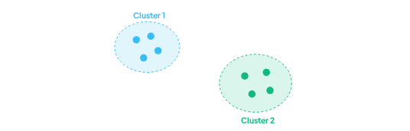
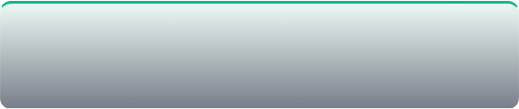
What is Clustering?
Clustering groups similar data points together without any prior labels.
In clustering, we are given raw data with no predefined target answers. We ask the machine: “Find the natural families or clusters that exist within this crowd.”
E-Commerce Customer Example:
Input: 50,000 customers with spending & visit frequency.
Output: Group 1 (Bargain hunters), Group 2 (Occasional luxury buyers), Group 3 (Daily commuters).
High intra-cluster similarity; high inter-cluster separation
Key phrase to teach: "High intra-cluster similarity, low inter-cluster similarity." Points inside a cluster should be tight friends; different clusters should stay far apart.

Slide 24



Visualizing: Classification vs. Clustering
Classification (Labels Given)
Clustering (No Labels Given)
Data + Known Labels Provided
Raw Data Only (All grey dots)
• Every row already marked Red or Blue.
• Goal: Draw a boundary line to separate them.
• No pre-existing classes or color tags.
• Goal: Discover if grey dots naturally form islands.
Question: “Is this newly received email Spam or Not Spam?”
Question: “Can we discover 3 natural customer groups in our mall data?”
Use colors as an analogy: In classification, the dots arrive painted blue and red. In clustering, all dots are plain gray; the algorithm paints them based on who sits near whom.

Slide 25




k-Means Clustering: Partitioning by Centroids
k-Means partitions N data points into K distinct non-overlapping clusters.
What is K in k-Means?
What is a Centroid?
K is the exact number of clusters you want the algorithm to create.
A centroid is the imaginary center point (the average/mean position) of all points inside that cluster.
You must specify K before the algorithm begins running.
Every cluster has exactly one centroid.
Warn students not to confuse "K" in k-NN with "K" in k-Means! In k-NN, K = number of neighbors voting. In k-Means, K = number of clusters being formed.

Slide 26

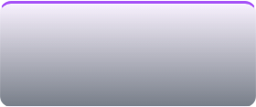
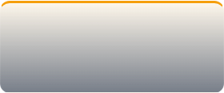
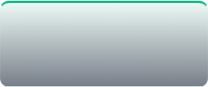
How k-Means Works: The 4-Step Cycle
Choose K
Random Centroids
Step 3 Assign Points
Move Centroid
Specify desired number of clusters (e.g., K = 2).
Pick K initial centroid points randomly on the plot.
Each point attaches to its nearest centroid.
Recalculate centroid to the center of its new members.
REPEAT Steps 3 & 4 until Convergence!
When centroids stop moving and no points change clusters, the algorithm has finished.
Analogy: Think of political leaders (centroids). At first, leaders stand anywhere. Voters gather around the closest leader. Then leaders shift their position to the exact center of their supporters!

Slide 27





k-Means Visual Convergence
Iteration 0: Random Starts
Iteration 1: Points Assigned
Final: Stability (Converged)
Centroids placed at random coordinates
Centroids shift toward cluster centers
Zero change in centroid position
Point out how fast k-Means converges (often in fewer than 10 iterations for standard classroom datasets).

Slide 28

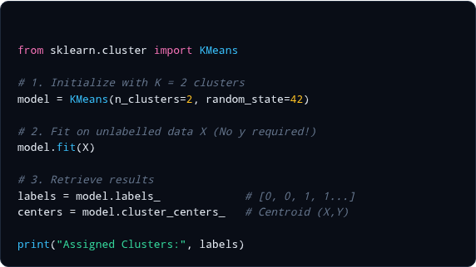
k-Means in Python (Scikit-Learn)
02_CLUSTERING/01_KMEANS/KMEANS_CLUSTERING.PY PYTHON 3.10+
Notice: model.fit(X)
Look closely: we pass ONLY X! In classification we did .fit(X, y). In clustering, there is no y label!
The Output Attributes
• model.labels_: Cluster tag for each data point.
• model.cluster_centers_: Coordinate points of centroids.
Demonstrate `kmeans_clustering.py` from the repo. Show how Matplotlib plots the data points with different colors for cluster 0 and 1, plus a big red X for the centroids.

Slide 29


Hierarchical Clustering: Bottom-Up Merging
Hierarchical clustering builds a tree of nested clusters instead of a single flat partition.
Agglomerative (Bottom-Up)
The Merging Progression:
1. Start with every single data point as its own tiny cluster.
Start: [A] [B] [C] [D] [E]
2. Find the two closest points and merge them.
↓ Merge closest: (A+B) (C+D) [E]
3. Repeat merging closest groups until all points become one single super-cluster.
↓ Merge next closest: (A+B+E) (C+D)
Final: (A + B + C + D + E) All in 1 Root
Classroom analogy: Imagine students entering an auditorium as strangers. First, desk-mates become pairs. Then pairs join neighboring benches. Finally, the whole class is one batch!

Slide 30


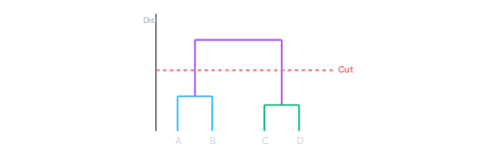

Understanding a Dendrogram
1. Leaves (Bottom)
Individual data points (A, B, C, D) before any merging begins.
2. Vertical Height
Represents the Euclidean distance between clusters when they merged. Tall lines mean merged clusters were far apart.
3. Cutting the Dendrogram
Cutting horizontal red line yields exactly 2 clusters
Draw a horizontal line across. The number of vertical lines it slices through determines your number of clusters!
Show how a dendrogram solves the "How do I choose K?" dilemma. By looking at the longest vertical lines without crossings, we identify the most natural cluster count.

Slide 31

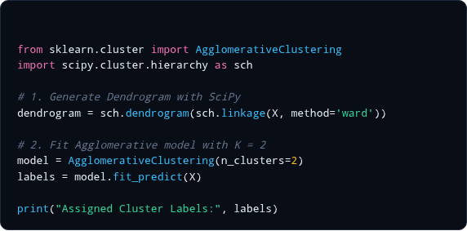

Hierarchical Clustering in Python
02_CLUSTERING/02_HIERARCHICAL/HIERARCHICAL.PY PYTHON 3.10+
Scipy vs. Scikit-Learn Roles
• SciPy: Perfect for computing linkages and plotting the visual dendrogram tree.
• Scikit-Learn: Provides AgglomerativeClustering to cut and output label arrays for every point.
Ward's Linkage Method
The default linkage method 'ward' minimizes variance within clusters, producing neat, compact groups.
Open `hierarchical.py` in VS Code. Run it so the Matplotlib window pops up with the full color-coded dendrogram chart.

Slide 32
k-Means vs. Hierarchical Clustering
Feature | k-Means | Hierarchical
Specification of K | Must specify K strictly beforehand | Does not require K initially (dendrogram decides)
Centroids | Relies heavily on centroids and means | Does not use centroids; merges by pair distances
Visual Output | Partitioned scatter points | Full hierarchical Dendrogram tree
Dataset Scalability | Very fast: Works on millions of records | Computationally heavy: Slow on massive datasets
When to Choose | Large, flat e-commerce / user datasets | Taxonomies, biology, small nested datasets
Summarize: If you have 1,000,000 records, choose k-Means because hierarchical clustering pairwise distance matrix will run out of RAM!

Slide 33







Complete Mining Techniques Map
CLASSIFICATION (Supervised)
CLUSTERING (Unsupervised)
Decision Tree
k-NN
Naive Bayes
k-Means
Hierarchical
“Questions”
“Neighbors”
“Probability”
“Centroids”
“Merging”
Have students recite the 5 one-word summaries: Decision Tree → Questions; k-NN → Neighbors; Naive Bayes → Probability; k-Means → Centroids; Hierarchical → Merging.

Slide 34




From Theory to Python Implementation
Concept
Small Example
Scikit-Learn Code
Visual Plots
Independent Lab
Intuitive real-world analogy
Manual dry-run on 5 rows
.fit() and .predict()
Matplotlib charts & trees
Hands-on coding mastery
Our Repository Architecture
01_classification/
└ 01_decision_tree/
└ 02_knn/
└ 03_naive_bayes/
02_clustering/
└ 01_kmeans/
└ 02_hierarchical_clustering/
Instruct all students to clone or pull the repository onto their lab machines. Every folder has a clean, standalone script that matches today's slide numbers.

Slide 35
Quick 5-Minute Classroom Quiz
1. Is Classification supervised or unsupervised?
Hint: Do we give the true answers during training?
2. In k-NN, what does K stand for?
Hint: Think about who votes on the new point.
3. Why is Naive Bayes called “Naive”?
Hint: What bold assumption does it make about features?
4. What is a centroid in k-Means?
Hint: What geometric property does it represent for its cluster members?
5. What does a Dendrogram represent in Hierarchical Clustering?
Hint: How does it visualize distances and cluster merges?
Engage the classroom! Call on individual students around the room for each question. Answers: 1. Supervised; 2. Number of nearest neighbors; 3. Feature independence; 4. Mean center point of cluster; 5. Tree showing cluster merge hierarchy.

Slide 36


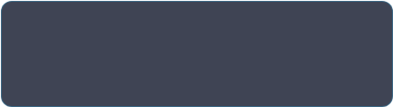
Key Takeaways & Next Steps
Classification Summary
Clustering Summary
• Decision Tree: If-Else questions
• k-Means: Discover centroids iteratively
• k-NN: Look at closest neighbors
• Hierarchical: Build bottom-up merge tree
• Naive Bayes: Calculate probabilities
• Unsupervised: Zero labels required
“Understand the core intuition first.
Then let Python do the heavy lifting.”
MITK • Department of Computer Applications • M.Tech CSE
Thank the students for their attention. Direct them to start the hands-on lab exercise in their machines.

